Slide 1
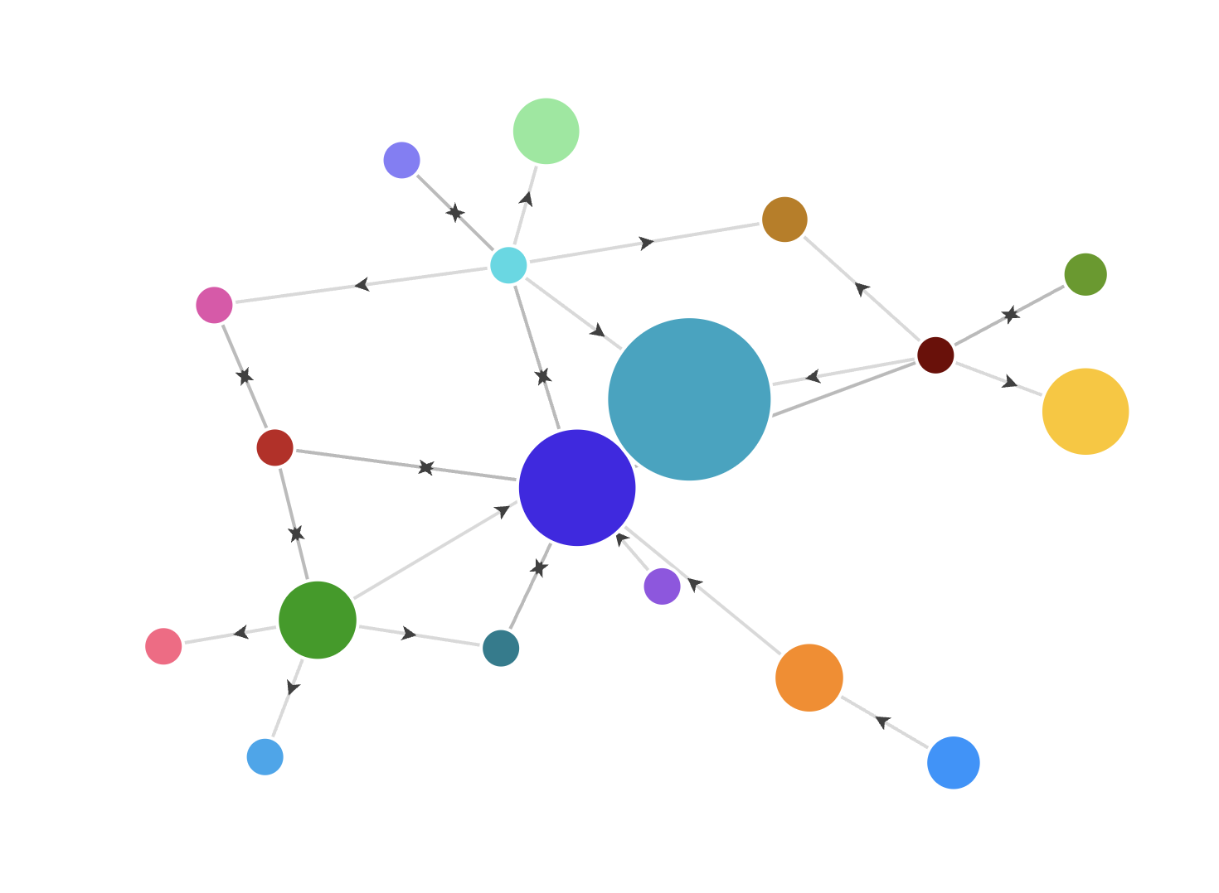
GrooveMapper
By: Sean Hackenberg
Instructor: Russ Feldhausen

Slide 2
Presentation Outline
Introduction
Background
Tools and Frameworks
Use Cases
Versions and Goals
Project Design
Project Implementation/Demos
Testing
Challenges
Future Work

Slide 3
Project Introduction
GrooveMapper
Analyze Spotify music data using a graph database in Neo4j to explore relationships between artists, tracks, genres, and albums.
Find new songs, artists, genres and more by leveraging graph queries.

Slide 4
Background
Personal Interest in Music
Spotify Wrapped
Receiptify
Graph Experience
Graph Focused Classes
Neo4j Exposure from Internships
Opportunity
Create a graph application for music exploration

Slide 5



Tools and Frameworks
Spotify API
Neo4j
Arrows
Python
Spotipy
PyVis
Flask
Neo4j
Draw.io

Slide 6
Use Cases
Genre to Genre Overlap
Find tracks that overlap between multiple genres
Artist to Artist Pathfinding
Find paths between artists through artist features on songs
Artist “essential” track analysis
Find an artist’s essential track
Artist recommendations
Find similar artists to a specified artist
Track recommendations
Find similar tracks through a specified track and track features/structures

Slide 7
Versions and Goals
MVP
Download Spotify Data and Load into Neo4j Graph
Visualize Graph with PyVis and Flask
Artist “essential” track analysis
Version 1.0
Artist to Artist path finding
Song Recommendation
Genre Overlap
Artist Recommendation
Version 2.0
Improved UI
Playlist Analysis
User listening history analysis

Slide 8
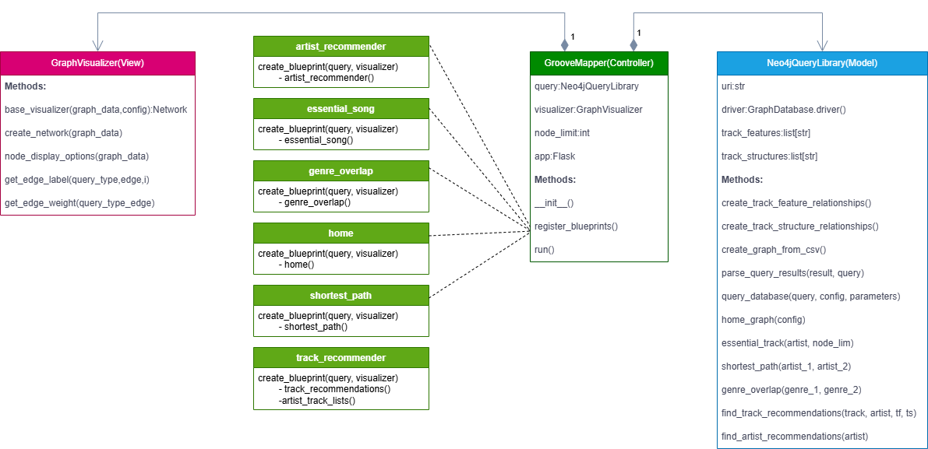
MVC UML Diagram

Slide 9
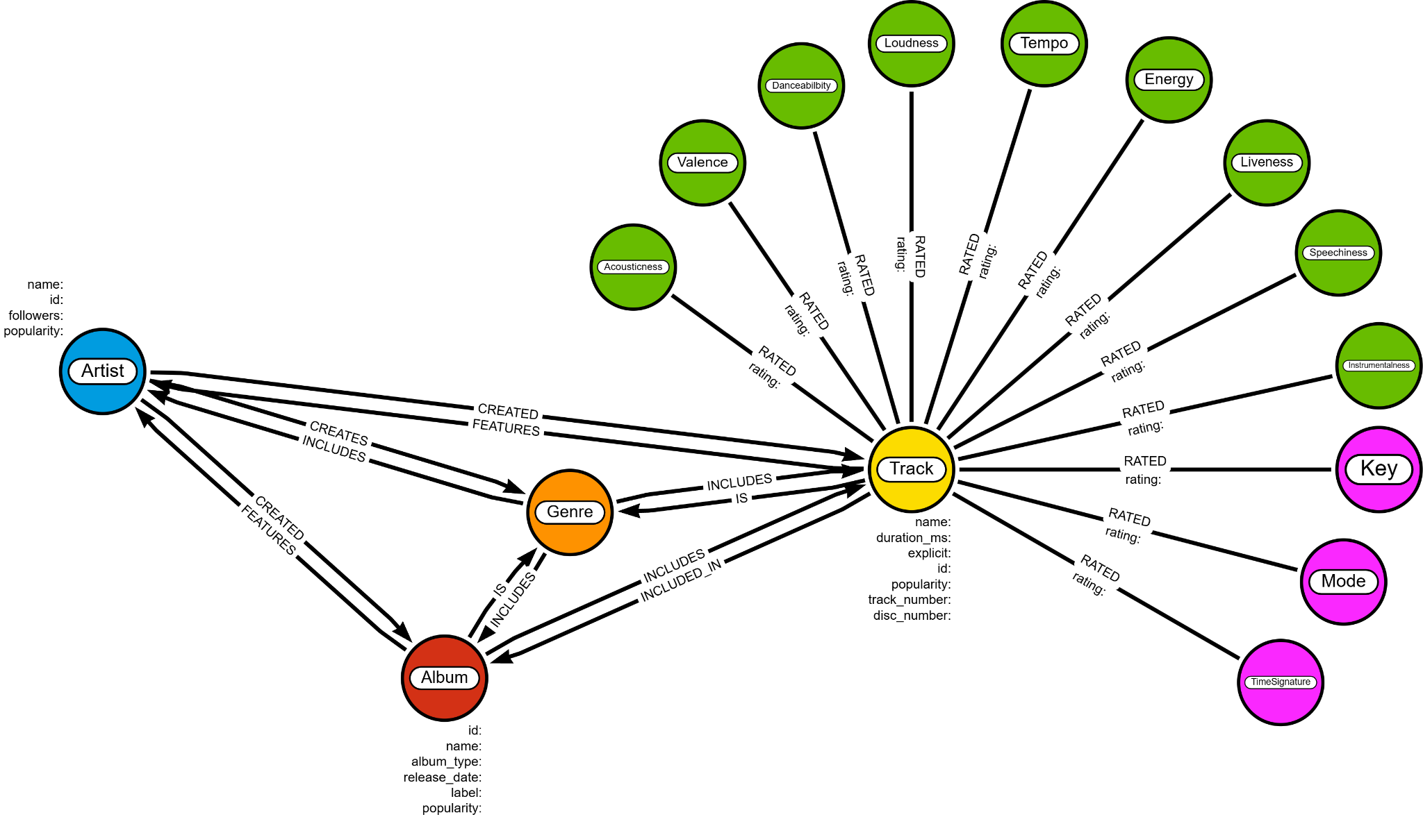
GrooveMapper
Data Model
Demo:
https://www.loom.com/share/77dd17f4cbc9464b97815e4997a62de7?sid=601beb9d-293e-454b-be65-531c2e2b638b

Slide 10
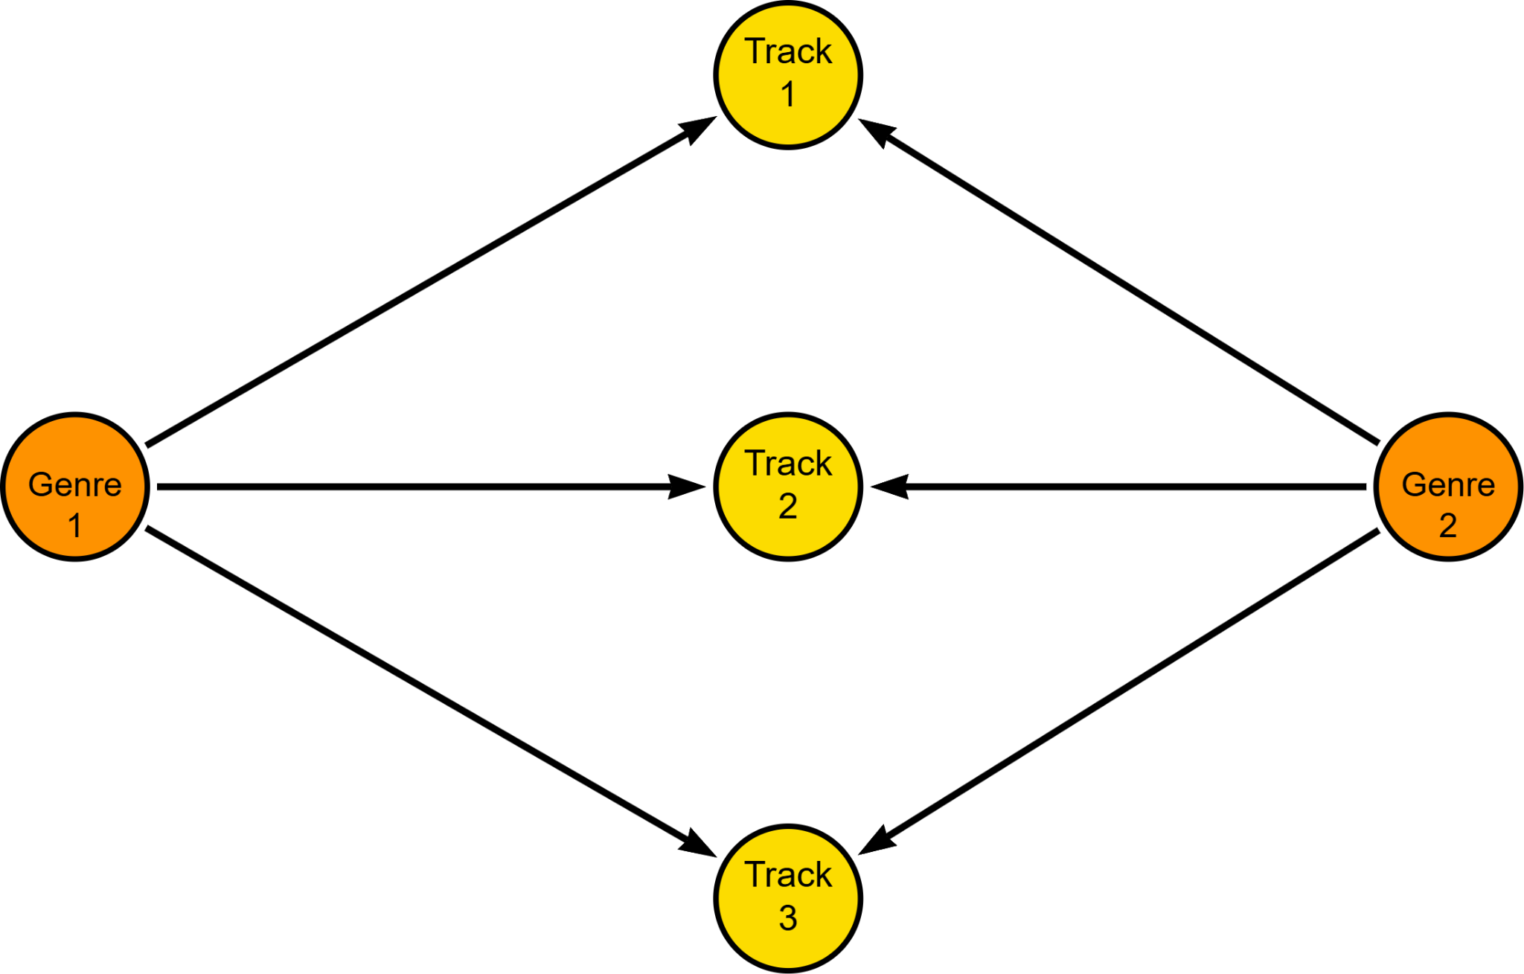
Inputs:
Genre 1
Genre 2
Query Plan:
Find Genre nodes and Filter tracks between them
Return most popular tracks belonging to both genres
Flask Endpoints:
/genre_overlap
[POST, GET]
Demo:
https://www.loom.com/share/634cbbec12414c2f8d163737bb1d6fea?sid=c404088c-594f-484d-9720-5c9f9a73ec5a
Genre to Genre Overlap

Slide 11
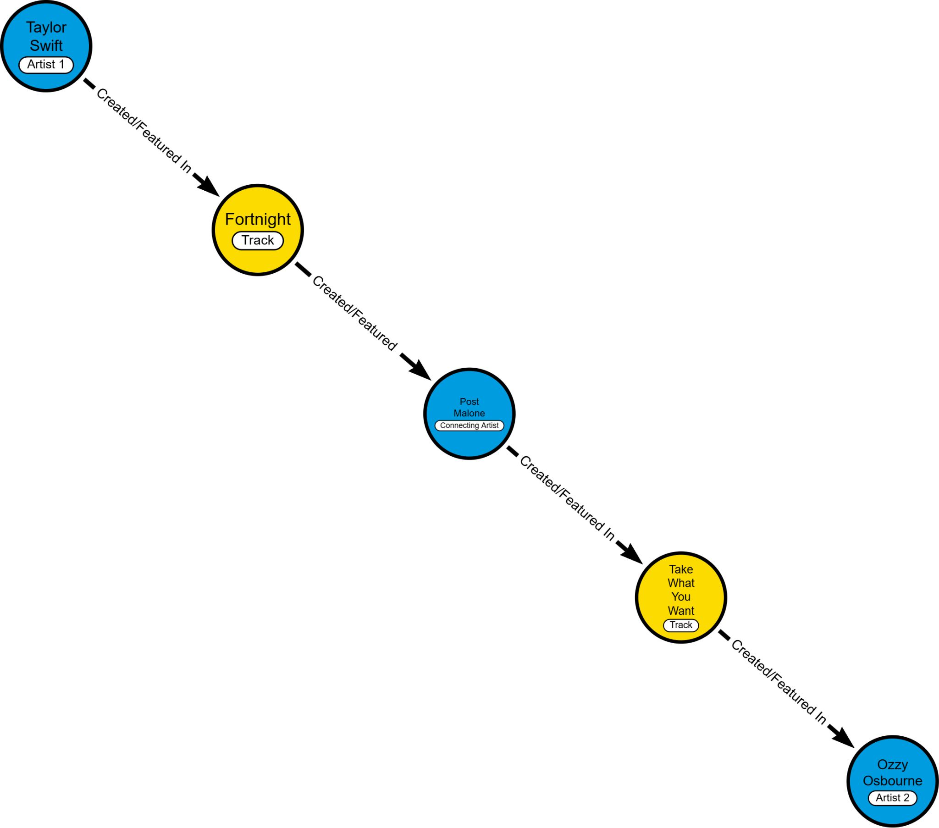
Inputs:
Artist 1 Name
Artist 2 Name
Query Plan:
Use shortest path algorithm on input artists
Flask Endpoints:
/artist_path
[POST, GET]
Demo:
https://www.loom.com/share/8e05a4dafef24de9996e6a3a123da3fc?sid=3e2f00a1-4e98-47f7-88fa-0706c16775ec
Artist to Artist Pathfinding

Slide 12
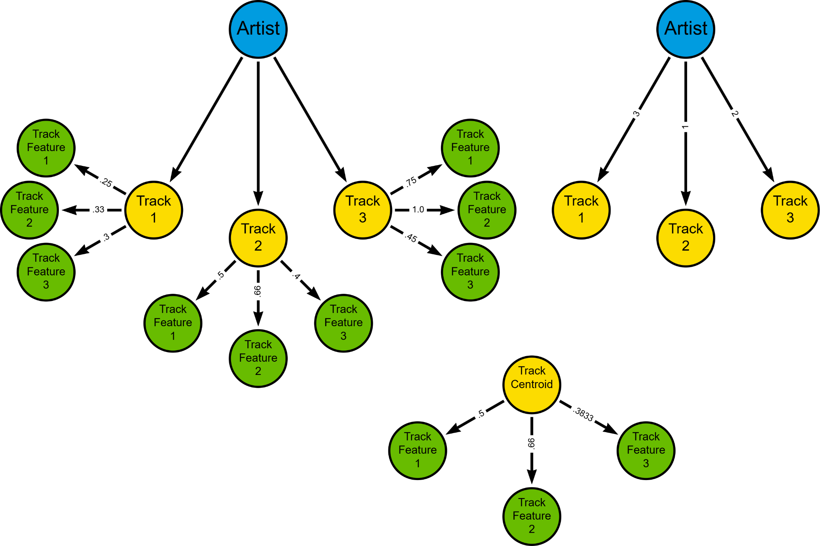
Inputs:
Artist Name
Query Plan:
Find artist and artist’s tracks
Create artist track centroid from track features
Return tracks nearest to track centroid
Flask Endpoints:
/essential_song
[POST, GET]
Demo:
https://www.loom.com/share/54067ef90759429fada002be1d4db814?sid=796f6fbe-1b51-45c7-a926-4f2666494a36
Artist “Essential” Track Analysis

Slide 13
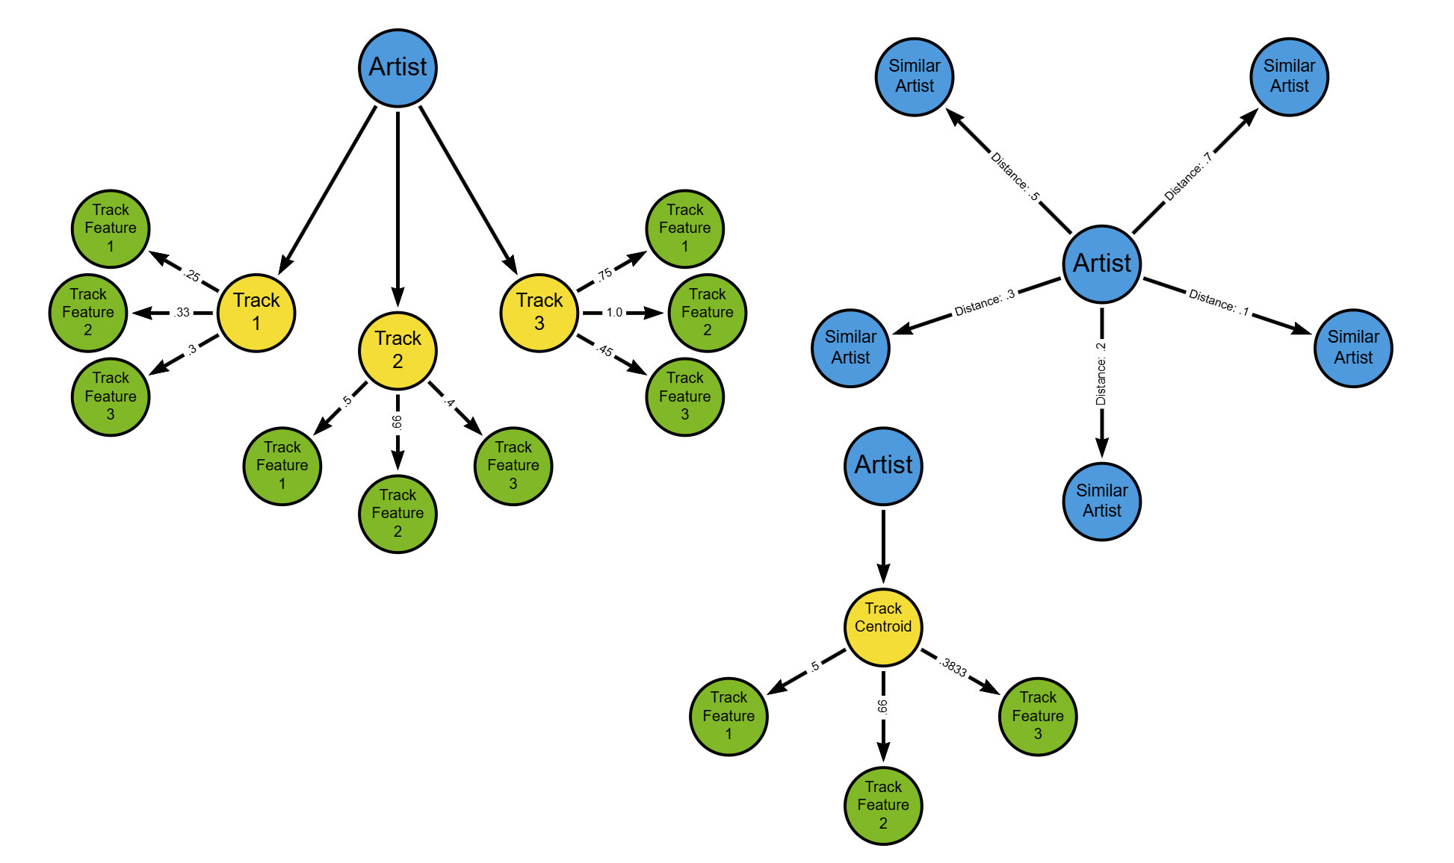
Inputs:
Artist Name
Query Plan:
Find artist and get track centroid data
Return artists with similar centroid data
Flask Endpoints:
/artist_recommender
[POST, GET]
Demo:
https://www.loom.com/share/94175a6b7d2f4dc49bae177cf7005b4c?sid=1f089165-ddf6-4397-af16-b770b9f9a31f
Artist Recommendations

Slide 14
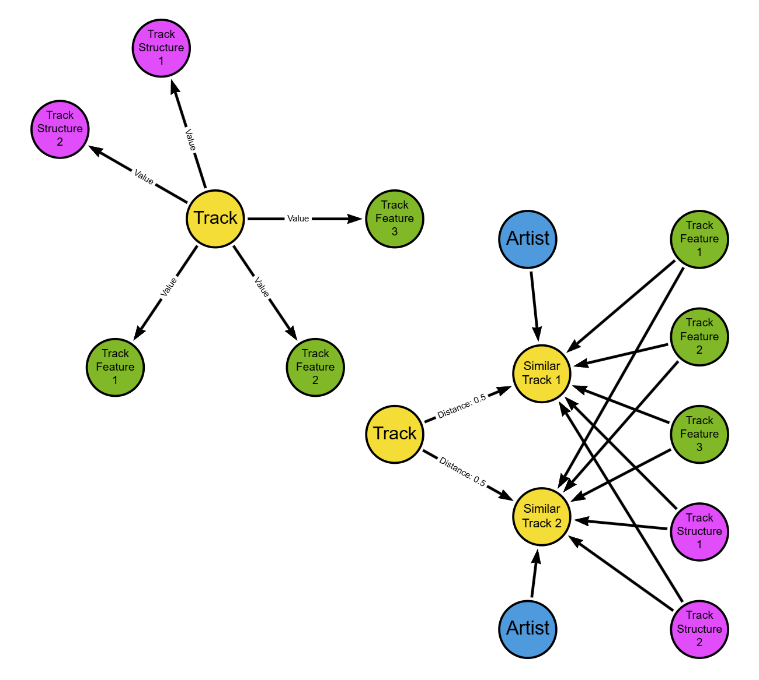
Inputs:
Track
Artist
Track Structure List
Track Feature List
Query Plan:
Find track and get values of track structures and track features
Filter tracks from track features and track structures
Return tracks most similar to input track
Flask Endpoints:
/track_recommender
[POST, GET]
Demo:
https://www.loom.com/share/c79f4010b3bb4978809684544b8f0b36?sid=8b25c523-9255-4291-a19b-9fd1ae0208a2
Track Recommendations

Slide 15
Flask Testing
Pytest for testing flask routes
Created tests for each query pages post request, and error messages if relevant
Created example graph data for each test

Slide 16
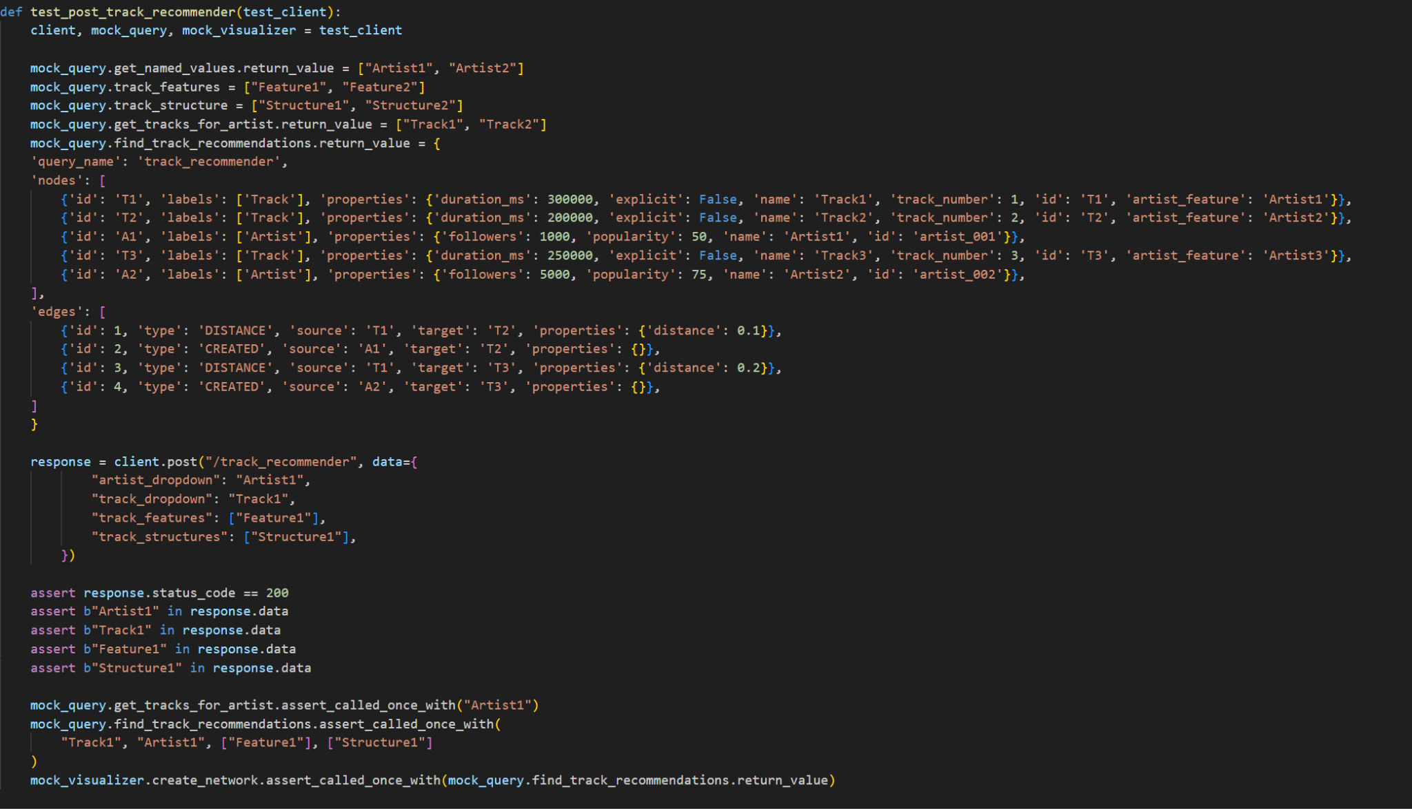

Slide 17
Challenges
Project Direction
Pivot from data science project
Spotify API Data Structure
Chaining together API calls
API rate limiting
Dataset Limitations
Genres tied to artists
Artist Features stored in Track Titles
Database load times
Learning Neo4j
Creating an efficient Graph Data Model

Slide 18
Future Work
Improved UI
Host Application on Server
Data Improvements
Cloud Neo4j Database
Accurate artist features on tracks
More data for better analytics
Spotify User Analytics
Spotify User Login
User based queries/playlist analytics

Slide 19
Thanks!
Summary
GrooveMapper: Web Application for Graph Exploration of Spotify Data
Tools and Frameworks:
Python, Neo4j, Pyvis, Flask
Query Pages:
Genre Overlap, Shortest Path, Essential Track, Artist Recommendation, Track Recommendation
Testing
Flask API data flow
Challenges
Data, Neo4j, Spotify API
Future work
Improved UI, Spotify Login Integration, Dataset Enhancements
Questions?

